Slide 1
Peer Mock Interviews
TIP101
Notes:
🌟 Purpose: Introduce the session and prepare students for peer mock interviews.
✅ What should I be doing?
Welcome students and set a collaborative tone for the session.
Emphasize the importance of mock interviews in building technical and communication skills.
🎙️ What should I be saying?
Welcome to Week 7, Session 2 of TIP101! Today, we’ll be conducting peer mock interviews. This is your opportunity to practice the skills you’ve been building in a real-world interview scenario.
Remember, the goal is to learn and improve—mistakes are part of the process, so don’t worry if things don’t go perfectly.
🙌🏽 How should I engage students?
Ask: "What’s one thing you’re looking forward to or hope to learn in today’s session?"

Slide 2
1 | Welcome 👋🏽 | 10 minutes
2 | Peer Mock Interviews | 35 minutes
3 | BREAK | 5 minutes
4 | AI Checkpoint #3 | 10 minutes
5 | Collaborative Problem Solving | 50 minutes
6 | Wrap Up | 10 minutes
Notes:
🌟 Purpose: Outline the session's structure and set expectations.
✅ What should I be doing?
Walk students through the schedule and ensure clarity about the activities.
🎙️ What should I be saying?
Here’s what we’ll cover today: We’ll start with peer mock interviews, take a short break, and then dive into collaborative problem-solving. We’ll wrap up with reflections and next steps.
The focus today is on applying the UMPIRE strategy and improving interview techniques.
🙌🏽 How should I engage students?
Pause to ask if anyone has questions or needs clarification about the schedule.

Slide 3
Welcome! 👋🏽
10 minutes

Slide 4


Turn on your cameras
Fill out the entry ticket
Notes:
🌟 Purpose: Encourage visual engagement to foster connection during the session.
✅ What should I be doing?
Prompt students to enable their cameras and submit the entry ticket.
🎙️ What should I be saying?
Let’s kick off our session by turning on our cameras!
Also, don’t forget to fill out the entry ticket to help us organize breakout rooms later.
🙌🏽 How should I engage students?
Use humor or compliments: "Let’s see those smiles!"
Acknowledge and thank students who turn on their cameras.

Slide 5
2 minutes
💻🍵Question:
Taking a virtual class gives you the flexibility to attend from any stable location. What are some of your favorite spots to get some work done away from home?
💬Answer:
Share your answer in the Zoom chat below. What kinds of pets do you have if any? If you don’t have any, share what type you would like to have, if any.

Slide 6
Tree questions were challenging but good practice.
Recursive explanation stuck for many
- Need a bit more practice on Trees & Recursion
- Tree traversal lecture could be more interactive!
Notes:
🌟 Purpose: Share feedback from the previous session and highlight areas of success and improvement.
✅ What should I be doing?
Summarize feedback from the previous session's survey and present key takeaways.
🎙️ What should I be saying?
From your feedback, it seems many of you enjoyed [highlighted aspect]. One suggestion was [area for improvement]. We’ll work on that today.
🙌🏽 How should I engage students?
Ask: "Does anyone have additional feedback or suggestions?"

Slide 7
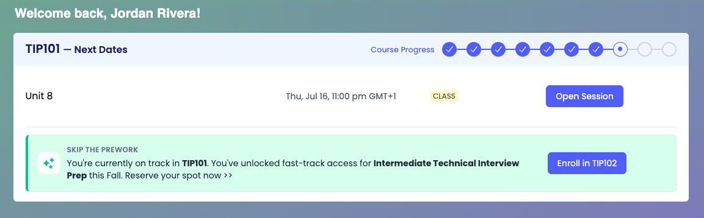
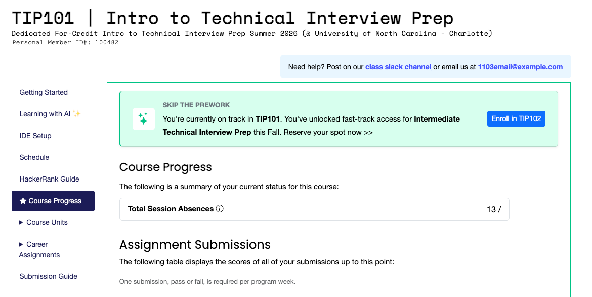
1
Student Hub dashboard
SKIP THE PREWORK
Your Fall 2026 seat is open
You're on track in your current course, so your seat at the next level up is open — no prework.
2
Course Progress tab in your course
Fast-track enrollment is open for Fall 2026 — take advantage of it this term.
Your seat may be contingent on passing, or completing, your current course.
Notes:
You're on track in your current course, so a Fall 2026 seat in the next one is already open — and you skip the prework. The green banner is live in two places: your Student Hub dashboard and the Course Progress tab in your course portal. It stays there until your course ends. Screens show TIP101 as an example.

Slide 8

Fall 2026 — CodePath, your future and you. We'll see you there.
Notes:
Simple close: Fall 2026 — CodePath, your future and you. We'll see you there.

Slide 9
Peer Mock Interviews
35 minutes

Slide 10
Today's Mock Interviews
Mock Interview Packet
One student will act as the interviewer.
Guides the process by asking questions, clarifying requirements, and prompting the interviewee to think about edge cases or optimization.
Observes and takes notes for feedback but does not solve the problem.
The other student will act as the interviewee.
Solves the problem while thinking aloud and applying the UMPIRE steps.
Communicates their thought process clearly to the interviewer.
Notes:
🌟 Purpose: Explain the roles and expectations for peer mock interviews.
✅ What should I be doing?
Clearly define the interviewer and interviewee roles.
🎙️ What should I be saying?
Here’s how the mock interviews will work: One student will act as the interviewer, guiding the process by asking questions, clarifying requirements, and prompting the interviewee to think about edge cases or optimizations.
The other student will act as the interviewee, solving the problem while thinking aloud and applying the UMPIRE steps. The key here is clear communication—you should explain your thought process as you go.
You’ll stay in your assigned role for the duration of the interview.
🙌🏽 How should I engage students?
Ask: "Does everyone feel comfortable with their roles? What questions do you have about how this process works?"

Slide 11
Peer Feedback
When there's ~5 minutes left, the interviewer should provide feedback:
One strength
One area for improvement
Notes:
🌟 Purpose: Highlight the importance of constructive feedback after the mock interview.
✅ What should I be doing?
Explain the structure and goals of the feedback session.
🎙️ What should I be saying?
At the end of the mock interview, the interviewer will provide feedback. Focus on one strength and one area for improvement.
This feedback is meant to help your peer grow and identify areas they can work on. Be specific and constructive.
For example, you might say, 'You did a great job explaining your thought process, but you could work on handling edge cases more thoroughly.
🙌🏽 How should I engage students?
Encourage thoughtfulness: "What’s one thing you’d appreciate hearing from a peer about your own performance?"

Slide 12
20 minutes
Problem #1 - Find the Difference
You are given two strings s and t.
String t is generated by randomly shuffling string s and then adding one more letter at a random position.
Return the letter that was added to t.
LeetCode Link
Interviewer Guide

Slide 13
20 minutes
Problem #2 - Ransom Note
Given two strings ransomNote and magazine, return True if ransomNote can be constructed by using the letters from magazine and False otherwise.
Each letter in magazine can only be used once in ransomNote.
LeetCode Link
Interviewer Guide

Slide 14
3 minutes
In the chat . . .
How did we do? What did we do well? What are things we need to work on to improve?
Notes:
🌟 Purpose: Reflect on the mock interviews and gather feedback on the process.
✅ What should I be doing?
Facilitate a discussion to help students consolidate their learnings from the interviews.
🎙️ What should I be saying?
Let’s take a moment to reflect. In the chat, share one thing that went well during the mock interviews and one thing we can work on to improve.
This is a chance to celebrate your wins and identify specific ways to grow as interviewers and interviewees.
🙌🏽 How should I engage students?
Read a few responses aloud, emphasizing actionable insights. Encourage follow-up: "Why do you think that approach worked well?" or "What’s one way you’d implement that feedback in your next interview?"

Slide 15

Break Time!
Take 5 mins to step away from the computer. Feel free to turn off your camera and return promptly after 5 mins.
Notes:
🌟 Purpose: Provide a short break to refresh and re-energize.
✅ What should I be doing?
Announce the break and remind students to return on time.
Play the countdown timer video (be sure to share sound).
🎙️ What should I be saying?
Let’s take 5 minutes to step away from the screen. Be sure to return promptly.

Slide 16
Collaborative Problem Solving
50 minutes

Slide 17
50 minutes
🏃🏽 Navigate to your breakout room.
👋🏽 Introduce yourselves!
🧑🏽‍💻 Work on the problems for your selected unit.

Slide 18
Wrap Up
10 minutes

Slide 19
Notes:
🌟 Purpose: End the session on a positive note.
✅ What should I be doing?
Prompt students to share their reflections in the chat.
🎙️ What should I be saying?
Let’s celebrate your wins. Share one good thing you learned or accomplished today!
🙌🏽 How should I engage students?
Read a few responses aloud and celebrate with enthusiasm.

Slide 20

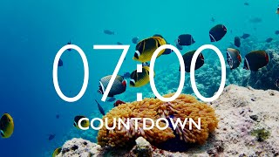
End of Course Survey Time!
7 min for End of Course Survey
Check your email for the link
Notes:
🌟 Purpose: Gather feedback to improve future sessions.
✅ What should I be doing?
Share the survey link and emphasize its importance.
🎙️ What should I be saying?
Your feedback helps us make these sessions even better. Please take a moment to complete the survey.
🙌🏽 How should I engage students?
Thank students for their input and explain how feedback has been used in the past.

Slide 21

Final Reminders
Finish the problem sets for additional practice
Take the weekly HackerRank assessment by Sunday @ midnight
Visit a Study Hall Session to deepen your understanding, work through challenges, and connect with course material alongside your peers!
Notes:
🌟 Purpose: Reinforce key tasks and deadlines.
✅ What should I be doing?
Summarize next steps and encourage continued engagement.
🎙️ What should I be saying?
Don’t forget to complete the problem sets and take the HackerRank assessment by Sunday!
🙌🏽 How should I engage students?
Encourage students to ask any lingering questions before signing off.

